Slide 1


SAP UI5 & FIORI with OData TRAINING using BAS
Anubhav Oberoy
Day – 5

Slide 2

Agenda – Day 5
Views In SAP UI5
Initializing JS view
What is Controller?
Structure of controller
Creating our first controller
How UI5 framework works
Basics of controller
Basics of OOPS
Concept of Control Hierarchy
XML View
Models in SAP UI5
Steps to Create a Model
Data Binding
Types of Data Binding Syntax
Types of Binding
Hook Methods of Controller
Modularization of model
Binding Modes.
Concept of Named Model
How to create Named Model
Expression Binding
Aggregation Binding
Changing the default Model at run time
Element Binding
Event Object concept
What is Resource Model.
Steps to create a Resource Model.

Slide 3
Views in SAP UI5
View is responsible to manage information display to the users.
Views are based on Model.
There are Four types of views in SAP UI5, these are listed below:
XML View:- It is in the XML format. The file name ends with the extension “.view.xml”. There are no predefined methods in the XML view.
JS View:- It is in JavaScript format. The extension of the view file is “.view.js”.
JSON View:- It is in JSON format. The file name ends with the extension “.view.json”.
HTML View:- It is in HTML format. The file name ends with the extension “.view.html”. Here we create the controls within the <div> tags, as we do while developing HTML pages.
Percentage Usage of Views:
2%
98%
JSON View – 0%
HTML view – 0%
JS View is used only in 2% of the views.
XML Views are the mostly used views now a days.
The use of JSON and HTML views are negligible

Slide 4
Initializing our First View (JS View)
Syntax of initializing a control in UI5
var objectName = new libraryName.className(sId, oProperties);
sId → unique id of our control
oProperties → are the information about the class in an object format.
Syntax of initializing a view
var oView = new sap.ui.view({
id: ‘’,
viewName: ‘’,
type: ''
});

Slide 5
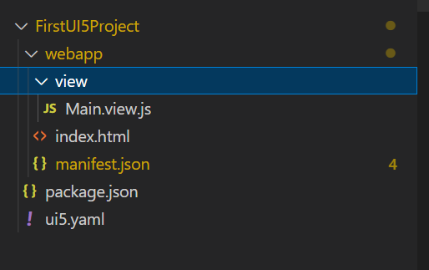
Hands – on: Initialize First View
Now create our first view.
Along with that we will add a button in the view using js view.
Code Links:-
index.html
Main.view.js

Slide 6

What is a Controller?
In SAPUI5 except the view, all the JS files will follow a special syntax to create a class (module). As we all know that in software development, the entire solution is designed by creating multiple classes, these classes work together to run our solution. We have dependencies between our class. The syntax which we use is responsible for loading our dependent classes.
A controller is also a class, but since its special (controller) class, we also need to inherit a special SAPUI5 class to mark it as controller. The name of special class is sap/ui/core/mvc/Controller.
In JS we use extend keyword to perform inheritance.
A module name is derived from a class name in SDK by replacing every dot (.) with slash (/)
This syntax will load all the dependent classes asynchronously, this is why the syntax is called AMD like syntax (Asynchronous module loading). Also called scaffolding template.
Skeleton of any JS file in SAP UI5 – Considered as a class
sap.ui.define([“dependencies”, “dep2”, “dep3”],
function(oD1, oD2, oD3) {
--logic—
}
);
The Syntax of the controller has the AMD(Asynchronous Module Loading) like structure . This is also Know as Scaffolding Template
Modules

Slide 7
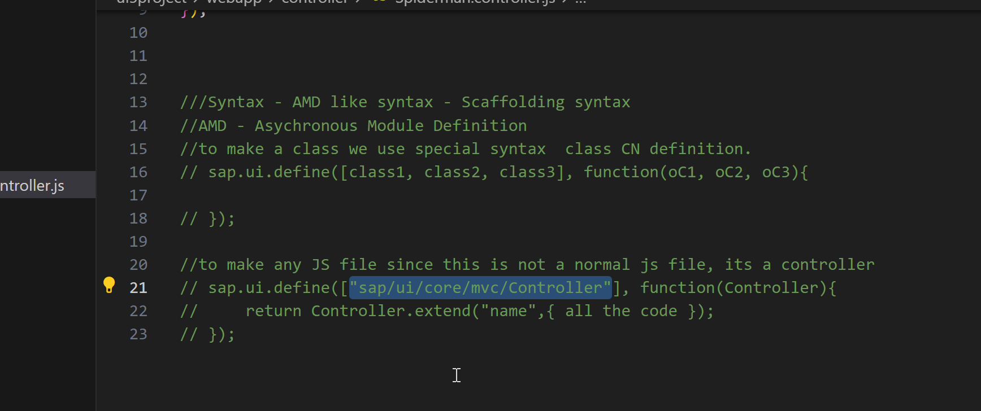














Slide 8


Structure of Controller
We define a simple controller as follows:
sap.ui.define([ "sap/ui/core/mvc/Controller" ],
function(Controller) {
"use strict";
return Controller.extend(“Address of Controller", {
// controller logic goes here
});
});

Slide 9
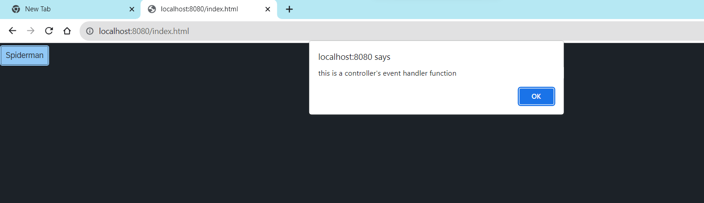
Hands – on: Create First Controller
Now to make our button work, we have to add some control logic to it, that logic will be written in the controller.
To add a controller to the project make a controller folder in the webapp directory and in that add a file named Main.controller.js.
In that file add the basic controller code in it and a function to show a alert message on click of the button.
Code Link:-
Main.view.js
Main.controller.js

Slide 10

How UI5 Framework works
Browser
CDN
SAP UI5 Framework
View
(Main.view.js)
controllerName=“…”
Call the controller Name
1
Index.html
3
The framework starts to find the controller with the same name
It will return controller name to the framework
var oView = new sap.ui.view({
viewName: “donald.view.Main",
type: “JS“
});
2
Loads the view
The object of the controller get all the controls .
6
8
Renderer
7
The view returns all the controls to the renderer
Controller
(Main.controller.js)
onInit() function
The renderer converts it into browser friendly language
Create the controller object
HTML + CSS
4
Call the constructor of controller
Get the object of the controller
5

Slide 11
Basics of Controller
A library name always starts with small letter and a Class name always starts with capital letter. Both will follow the camel case.
Enumerators are constant values, example for type of button we use enum ButtonType
For a control we have properties, aggregation, events, function name, they always follow camel case
A controller contains methods that defines how models and views interact.
Whenever we see a property for a control, we will always have setter and getter methods to manipulate and read the property value. E.g. an Input control has value property, we will have setValue and getValue method for the same.
In order to work with a control inside the controller, we need to obtain object of that control. To obtain the control object we must not use the document.getElementById because it will give the object of HTML control not the object of UI5 control.
To obtain UI5 element object, we need to first get View Object,
We will obtain the view object inside the controller using this.getView()
‘this’ is the object of my current class, so inside controller it will point to current class
We can now obtain the object of the control using this.getView().byId(controlId)
For every event in UI5, we have attachEvent, detachEvent, fireEvent methods as well, which can be used to link, delink and trigger event programmatically.

Slide 12
Basics of OOPS (Object Oriented Programing)
PASSENGER
+passport no +name +nationality
Walk(), talk(), print_boarding()
0..n
PLANE
+Airline +Width +Height
+fly(), +land(), #load()
ENGINE, WINGS
+capacity, +speed, +color
inheritance
PASSENGER PLANE
+no_of_seats
Load()
CARGO PLANE
+cargo_space
Load()
Association (relation between classes which are not of same group of family)
1. Aggregation – lose coupling, both objects can function independently, SHOULD have relation
2. Composition – tight coupling, both cannot function independently, MUST have relation

Slide 13
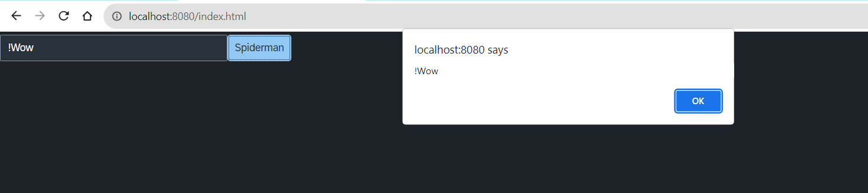
Hands – on: Input Field and Button Together
Now we will an Input field in the view.
On press of the button whatever is written in the input field will be displayed in the alert message.
Code Link:-
Main.view.js
Main.controller.js

Slide 14

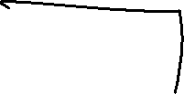











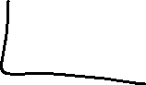

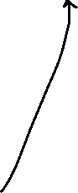





Concept of Control Hierarchy
Concept of control Hierarchy tells us about how the SAP UI5 Controls are structure on the basis of the object oriented Paradigm.
Note:- Whenever we see a control, and if we are unable to find a property, association, event or function in that class, check its parent class.
sap.ui.base.ManagedObject
sap.ui.core.Element
sap.ui.core.Control
sap.m.Button
sap.m.InputBase
sap.ui.view
sap.m.Table
sap.ui.layout.form
sap.m.Input
sap.m.Column
SimpleForm
Some Frequently used Controls

Slide 15
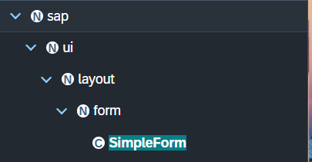
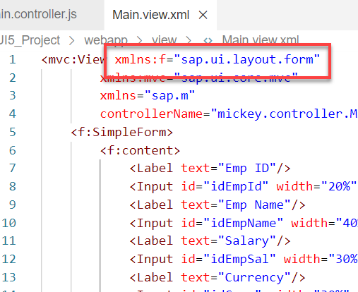
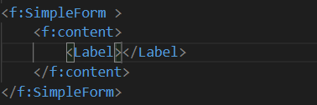
Basics of control hierarchy
To use any control , first we have to include controls’ parent class into the view
For example: To use the SimpleForm we have to include its parent class which is sap.ui.layout.form
The namespace have to given to the parent class
xmlns:f=“sap.ui.layout.form”
When we use the aggregation of any control same namespace will follow by the aggregation as parent.
The control name must start with capital letter and the aggregation name starts with small letter.
We have to check which control will aggregate to the control itself, if the aggregate control is the Control class or element class we can pass any of their child class to the aggregation.
for example:
As the <f:content> extend the element class we can use the <Label> which is also child of element class inside the <f:content>

Slide 16
XML View
What is XML?
XML stands for eXtensible Markup Language, it was originally developed to move data from one to another technology. It became popular to communicate between heterogeneous technologies.
XML is a tree data structure. Unlike HTML, we can use custom tags. Every programming language must support XML.
Portal
Java
App
ABAP
If_ixml
xml
xml
Data Objects → XML – Rendering
XML → Data Object – Parsing
Why XML View is better than other Views?
It is industry Standard.
XML handles the control id properly
XML rendering is faster
XML properly follows the MVC
Architecture.
JS view violets the principle of MVC due to which XML views are the preferred choice.

Slide 17
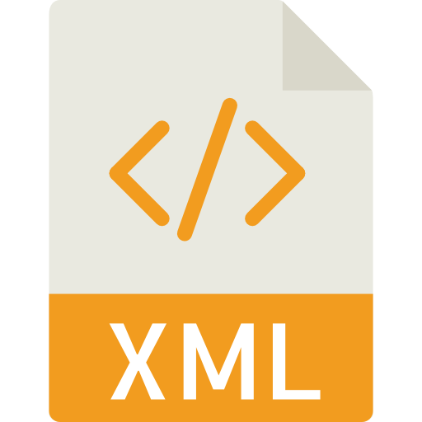
Structure of XML
<data>
<empStr>
<empId>5000</empId>
<empName>Jack</empName>
<salary>9500</salary>
<currency>EUR</currency>
</empStr>
<empTab>
<row>
….
</row>
</empTab>
</data>
Root Element
Child Element of <data> tag
Child Element of <empStr> tag
Skeleton of XML View
<mvc:View xmlns:mvc=“sap.ui.core.mvc” xmlns=“sap.m” controllerName=“pathOfContro.”>
<Button text=“Click Me”></Button>
</mvc:View>

Slide 18
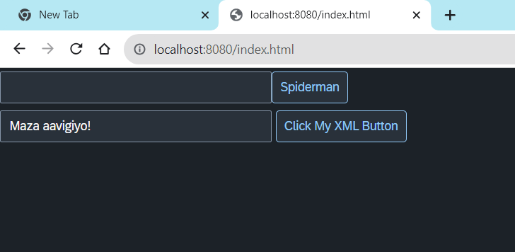
Hands – on: Create First XML View
Now we will create our first XML view.
For that create a new file ‘MyXML.view.xml’ in the view folder of the webapp directory
Then add the View code to this file and save. It will show a button on the screen.
Code Link:-
index.html
MyXML.view.xml
Main.controller.js

Slide 19
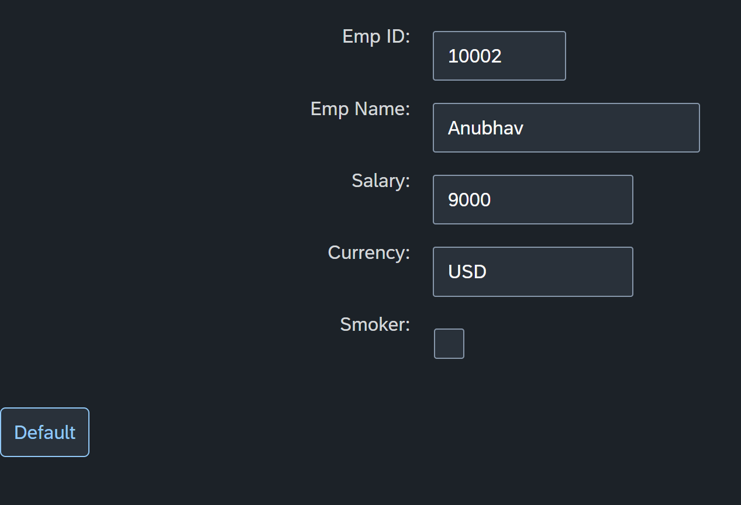
Hands – on: Simple Form Control
Now create a Simple form control in the View.
Along with that we will add a button below the Simple form and on press of that button change the value of one field in the Simple form.
Code Links:-
Main.view.xml
Main.controller.js

Slide 20
Models in SAP UI5
Models are the Object of the data. It contains all the data related to the application .
The various model types supported by SAPUI5 are:
OData model
JSON model
XML model
Resource model
Each model in SAPUI5 is mainly used to bind controls to the data brought in. The JSON model is a client-side model which is recommended for datasets with small amounts of data.
Server Side Model
These three are the Client side model
%
Usage of Models:
100
100
100
95
80
Usage in Percentage
60
40
40
20
Models
OData
JSON
XML
Resource

Slide 21
Model Basics
All the models in SAP UI5 are characterized in two different parts:
Client-Side Model: -
Client Side Model are the models which keeps the data in the browser (client side), when app starts all the data will be loaded in one shot to the browser and kept there.
These models are used when the dataset is small and we want to manipulate data locally.
E.g. why we use internal table? – it’s a temporary store to manipulate the data and once we finalize we push data back.
Server-Side Model: -
Server Side Model are the models which keeps the data in the SAP system(server side), when app starts all the data will be loaded in one demand to the browser in a client side model from, server side model.
These models are used when the dataset is large and we want to fetch and store data back to SAP.
Imagine we have 20trillion records in our sap system, we cant access all data at once in mobile fiori app, so we use server side model to load it chunk by chunk.

Slide 22
Steps to Create a Model
There are 4 Easy Steps to Create a Model:
Step 1: Create a brand-new object of the Model
To Create JSON Model - var oModel = new sap.ui.model.json.JSONModel()
To create XML model – var oModel = new sap.ui.model.xml.XMLModel()
To create Resource model – var oModel = new sap.ui.model.resource.ResourceModel()
To create OData Model – var oModel = new sap.ui.model.odata.v2.ODataModel()
Step 2: Set or Load the data in the Model
oModel.setData({});
oModel.loadData(filePath);
Step 3: Make the model aware to the application/view
sap.ui.getCore().setModel(oModel) -- whole city knows where the gold is
this.getView().setModel(oModel) -- only the single view and its child control knows – only my family
this.getView().byId(“controlId”).setModel(oModel) -- one control have access to data – my dad
Step 4: Data Binding : It is the concept of mapping the Views and Model with which the UI knows where the data is into the model. This is done by calculating the path (address of the data).
Create object of the Model
Set/Load Data in Model
Set Model at View Level

Slide 23
Data Binding
Data binding is the process that establishes a connection between the application UI and business logic.
It is a bridge between a binding target(View) and a binding source(Model).
In the json data we can make address as “Every curly braces is converted to / and every array item is converted to /index”.
{"empStr": {
"empId": 0001,
"empName": "Anubhav",
"salary": 8000,
"currency": "USD"
},
"empTab": [{
"empId": 0009,
"empName": “Ananya",
"salary": 9500,
"currency": "USD“
}, {
"empId": 0010,
"empName": “Shwetha",
"salary": 10000,
"currency": “EUR"
}]}
Q: what is the salary of Anubhav
/empStr/salary
Q. What is the emp name of emp 0001
/empStr/empName
Q. What is the salary of Shwetha
/empTab/1/salary
Q. What is the empId of Ananya
/empTab/0/empId
This is the address of the data
To bind the data with the view we have to give the path of the data , so we have to use the curly braces as :
{/empStr/empName}
This is the path of the data

Slide 24
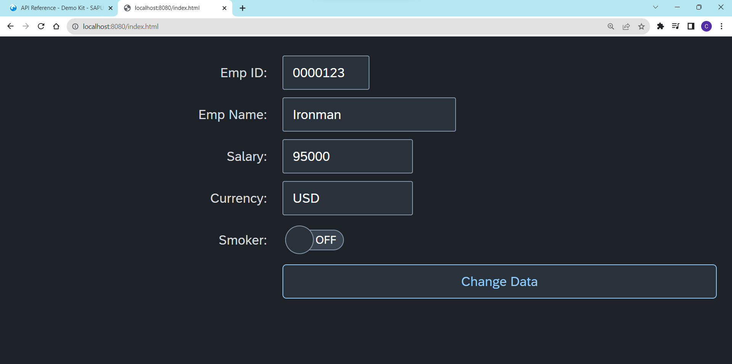
Hands – on: Create our first Model
Create a JSON model by following the steps explained in the previous Slides.
After Creating the Model bind the model to the SimpleForm using different binding Syntaxes.
Code links:-
Main.view.xml
Main.controller.js

Slide 25
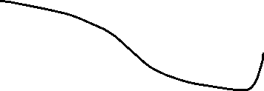

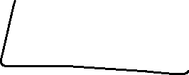

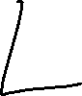
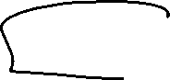

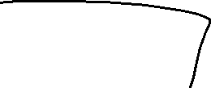
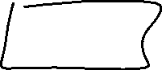





Slide 26
Different Methods to Bind Property in View
Binding using the path of the data
{/empStr/empId}
Binding as property specific method:
this.getView().byId(‘controlId’).bindValue(‘/empStr/empSalary’)
Binding as property generic method:
this.getView().byId(‘controlId’).bindProperty(‘value’ , ‘/empStr/empSalary’ )
Binding using the path expression , this is also know as complex binding syntax
{path : ‘/empStr/empId’}
this syntax is helpful when we use formatter .
this syntax will not work by default until we inform it to the SAPUI5, to make this syntax work we have to add a line
code inside the bootstrap code of the application.
data-sap-ui-bindingSyntax= “complex”
Name of the property with which we want to bind

Slide 27
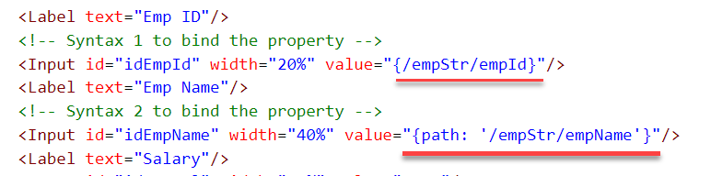
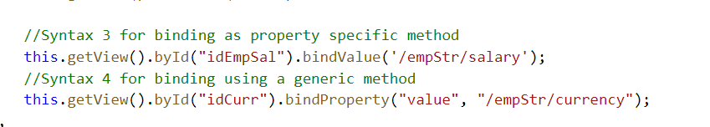
Hands – on: Binding Syntax
Now we will see the different syntax of binding the properties in the View.
Along with that we will see how to align the label and fields in the SimpleForm control.
Code Links:-
MyXML.view.xml
Main.controller.js
Index.html

Slide 28

Types of Binding
SAP UI5 have 4 types of Binding options:
Property Binding
Expression Binding
Aggregation Binding
Element Binding
Property Binding:-
When we bind property of a UI control, to the address/path of the model, this is called property binding. E.g., value property of Input control was connected to /emp/empId
All the four syntaxes we studied in previous slide are the example of property binding.
Ex:-
In XML view:-
<Text text=“{/emp/empId}” ></Text>
In controller: -
this.getView().byId(“controlId”).bindProperty(“text”, ‘/emp/empId’);

Slide 29
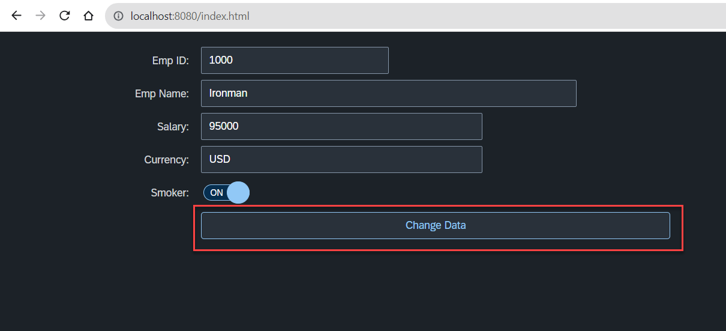
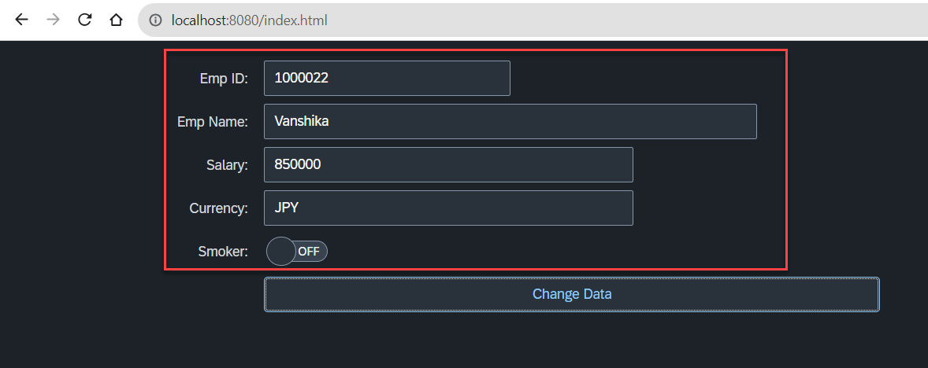
Hands – on: Changing data using Model
Now we will change the form data using the setProperty and getProperty functions.
Initially we used these functions to set the data directly now we will use the Model to change the data.
This process will be done on click of the Change Data button.
Code Links:-
MyXML.view.xml
Main.controller.js

Slide 30
Hook Method of Controller
onInit()
onBeforeRendering()
It is a function which gets called immediately after UI5 creates the object of our controller. It is like constructure of a class. We can use this to initialize our class variable
It is a method which gets called MULTIPLE times, Before every time the view is displayed to the user. We can use this method for pre-processing on a view.
IN
BR
EX
AR
onExit()
onAfterRendering()
It is a function which gets called before the instance of our controller gets destroyed. It is like destructor of a class.
We can use this to write clean-up code.
It is a method which gets called MULTIPLE times, After every time the view is displayed to the user. This method can be used to show effects to the user.

Slide 31
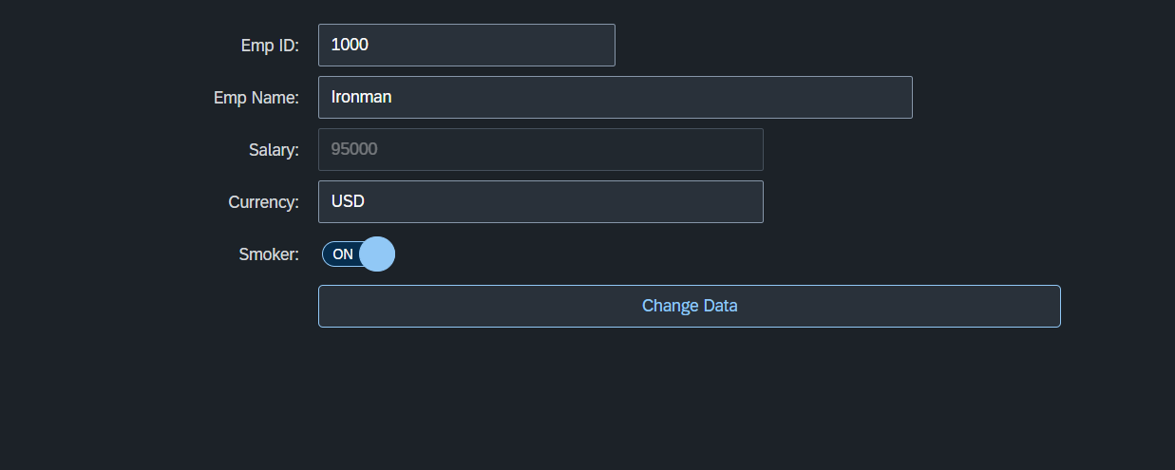
Hands – on: Hook Methods and Global Variable
Now we will see how to create a global variable and use it.
We will also see the use of Hook Methods of a controller.
Code Links:-
MyXML.view.xml
Main.controller.js

Slide 32
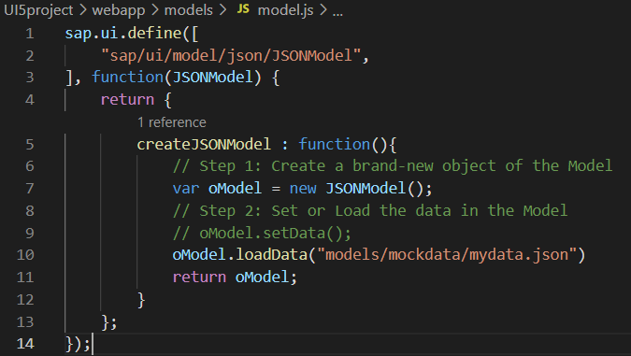
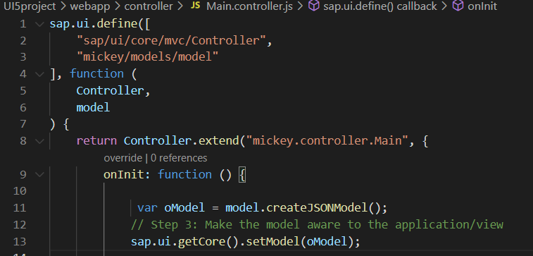
Modularization of Model
1. Create a folder in webapp with name models.
2. Inside models create a file name model.js and then create the function named createJSONModel: function(){}
3. Now create a folder inside the models named mockdata and then inside mockdata create a file named mydata.json
4. Inside the mydata.json put all the data in JSON format.
5. Then inside the models.js :-
6. Then call the model.js inside the controller and create the object then by using the object call the function of model.js
Loading the data from mydata.json using loadData() function
Call the model.js into the controller as dependency.
Object of the model.js
Call the createJSONModel function using the object

Slide 33
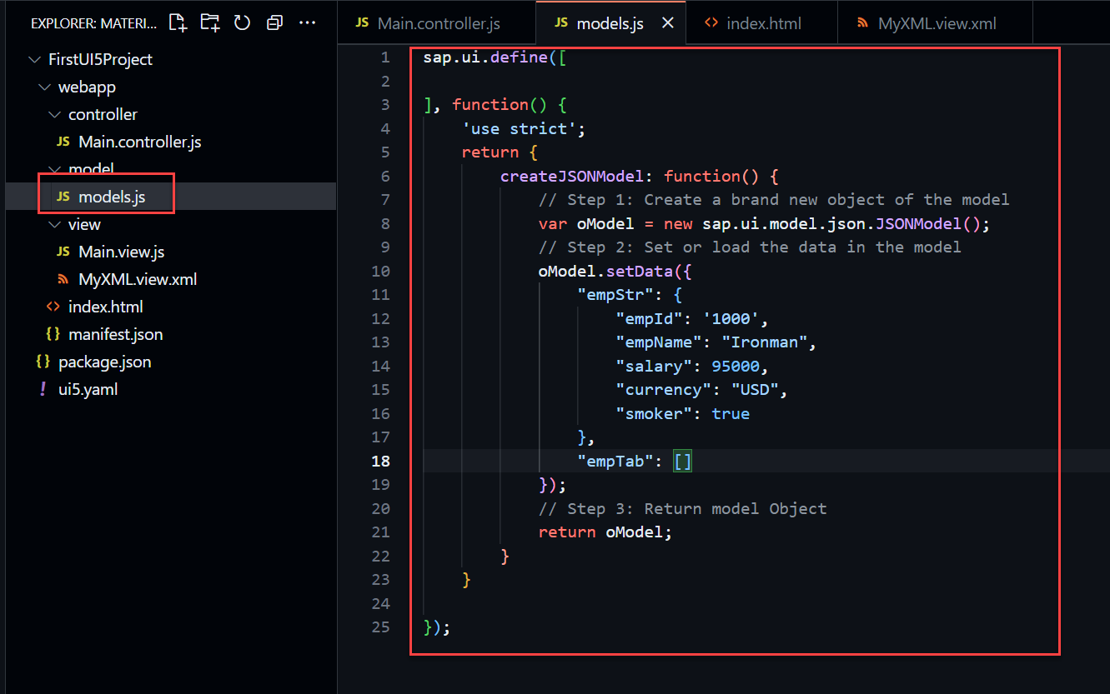
Hands – on: Modularize the Code
Now modularize our model code using the steps shown in the previous slide.
We will also see how to load the data form the model.
Code Links:-
Main.controller.js
models.js

Slide 34
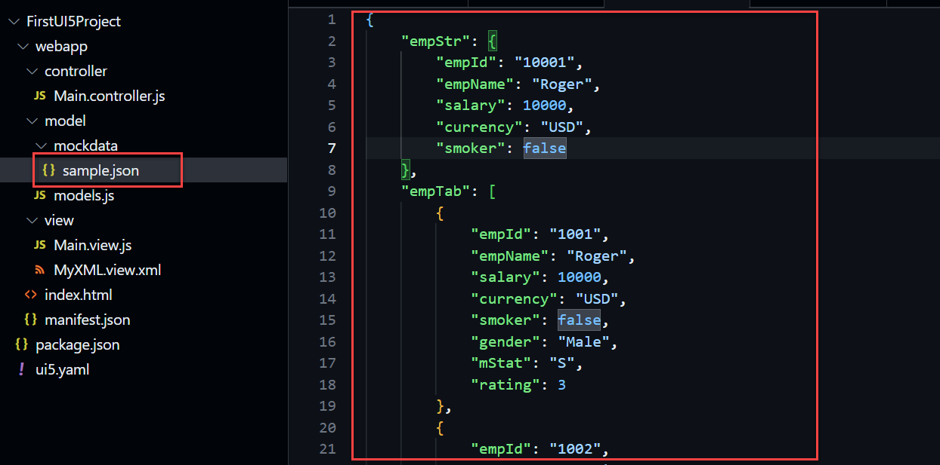
Hands – on: Loading data from file
Till now we have loaded the data in the model from the json structure only.
Now we will load the data into the model from a file.
There will be now change in the output but now the data will be loaded from the sample.json file
Code Links
sample.json
models.json

Slide 35
Binding Modes
There are basically three modes of binding data in SAPUI5.
One-way binding – Here, the data is transported in one direction only, i.e., from the model, through the binding instance to the consumer (usually the property of a control), but never in the other direction. Any change done on the model data from the front end is not affected to the model. All the data changes are reflected only on the controls.
Two-way binding – Here all input changes done from front end controls are reflected on the model and the backend database. SAPUI5 automatically handles the transport of data both from the model to the controls and back from the controls to the model. It is the default binding mode.
One-time binding – Here all data will be bound from model to view just once. After that, the connection is no more set.
Data
Data
Model
View
Model
View
Data
One-way binding
Two-way binding
Data
Data
Data
Model
View
Model
View
One-Time binding

Slide 36
Concept of Named Model
Concept of named model comes into observation when we want to use more than one model simultaneously in one application. When we uses two model simultaneously the there are some conflicts arises in the application , as the second model we use will overwrite the data of the first model. So, here we use the Named Model
Creation of Named Model :
this.getView().setModel(oModel2 , “Name of the model”) ;
For example :
this.getView().setModel(oModel2 , “thanos”); → here thanos is the name of the model
Binding using the Named Model:
So in binding we use this name, to bind the data from the named model we use modelName>path in binding syntax
For example:
“{thanos>/empStr/empName}” this will bind the name from thanos model.

Slide 37
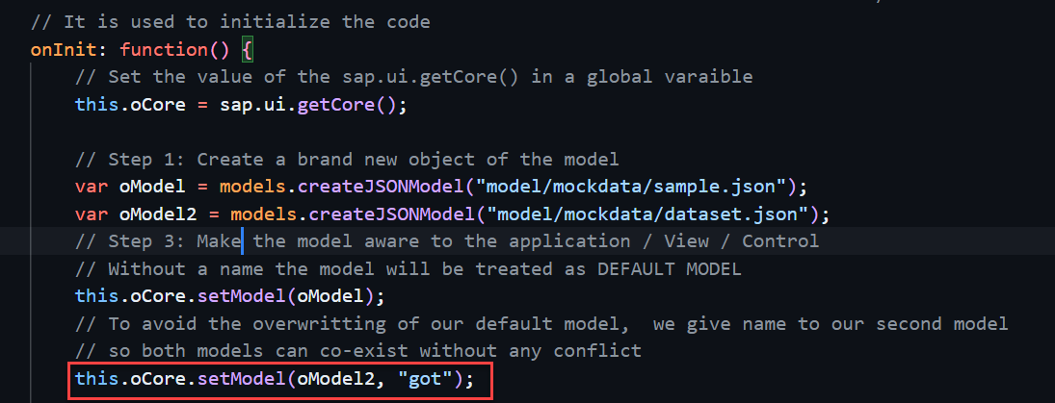
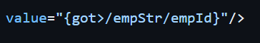
How to create a Named Model
Create a model (dataset.json) in the models folder .
In controller , we have to give the path in the createJSONModel() function
In model.js we have to pass the path as a parameter to create the model with different paths form the same function.
To bind the data in view , we have to use the name of the named model.

Slide 38
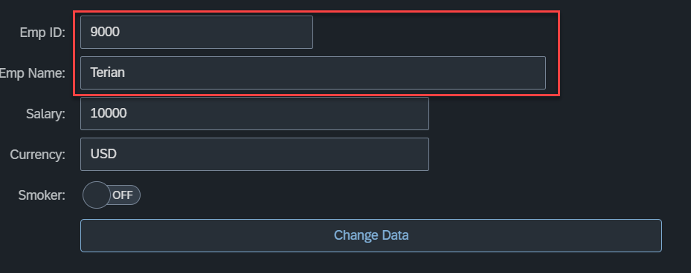
Hands – on: Named Model Creation
Till now we have loaded the data in the model from the json structure only.
Now we will load the data into the model from a file.
There will be now change in the output but now the data will be loaded from the sample.json file
Code Links
dataset.json
models.json
Main.controller.js
MyXML.view.xml

Slide 39
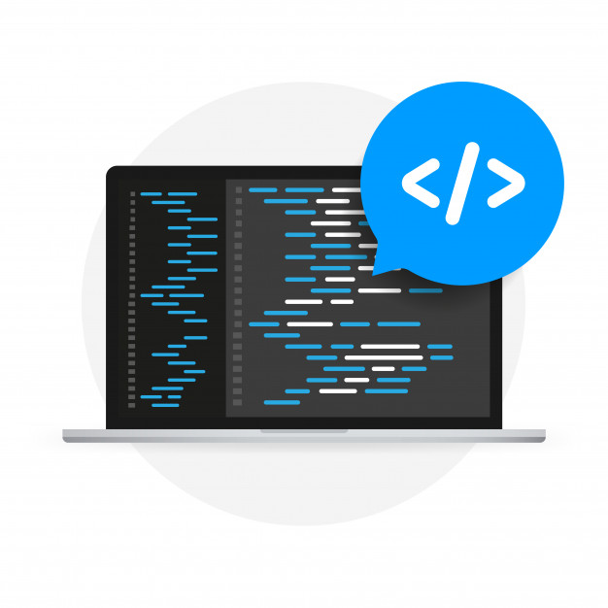
Expression Binding
Expression binding : - When we bind an Expression ({= condition ? true : false}) with the property of a control rather binding value to a property, this is called expression binding.
If we need some calculation on model data or some sort of comparison, then expression binding is useful.
Syntax:
numberState = “{= ${path} > value ? ‘conditionForTrue’ : ‘ConditionForFalse’ }”
Use Case of Expression Binding
My Manager want to add a make salary field grayed(read-only) whenever the employee name is Anubhav.
If The Employee Name is Anubhav, the salary must be 20000.
Condition – if employee name = Anubhav
Outcome – the salary must be 20000
Target – Salary field

Slide 40
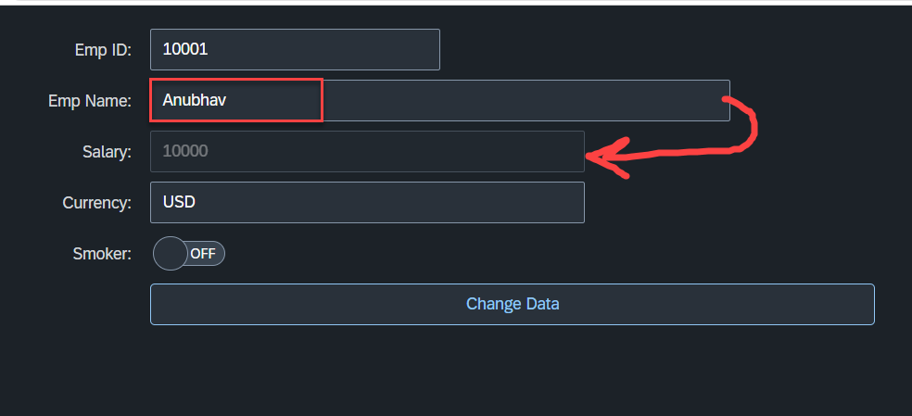
Hands – on: Expression Binding
Now we will bind the Salary field in the SimpleForm with the help of Expression binding Syntax according to the use case mentioned in the previous slide.
Before that we have to comment the line in the controller in which we are binding it form model.
Code Link:-
MyXML.view.xml
models.js

Slide 41
Aggregation Binding with Table Control
When we bind the aggregation of a control with the entityset of data model, it is called aggregation Binding.
The parent control (e.g. Table) is bound to the EntitySet path which is called absolute path and the child of the parent Control (e.g. Columns) are connected to the child properties of the EntitySet is called relative path.
In aggregation binding, based on your model data, as many child controls will be created automatically.
Every Event of UI5 will trigger the eventHandler and we will get the Event Object as part of the event Handler. Depending on the event, the event handler object will have different parameters.
Use Case of Aggregation Binding
If we want to show a list or some data in tabular format, we need to bind a group of data. In such a case we will use aggregation binding.
Absolute path
{
“empTab”: [
{
“empId”: 50,
“empName”: “Jay”,
“salary”: 9500
}
]
}
Table = {/empTab}
Emp Id | Emp Name | Salary
{empId} | {empName} | {salary}
Relative Paths

Slide 42
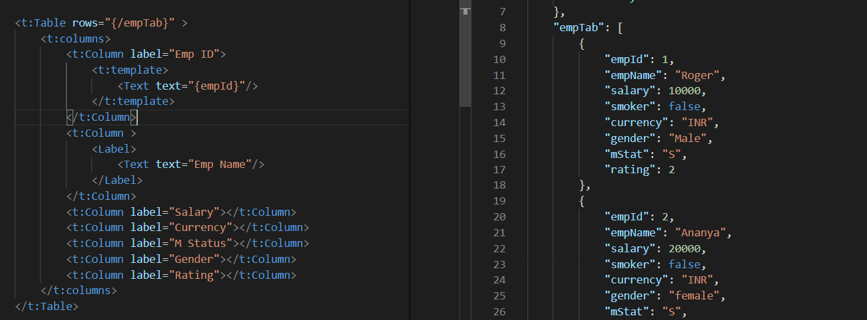
Absolute Path : Connecting parent to parent
Relative Path : connecting child to child respective to parent control

Slide 43
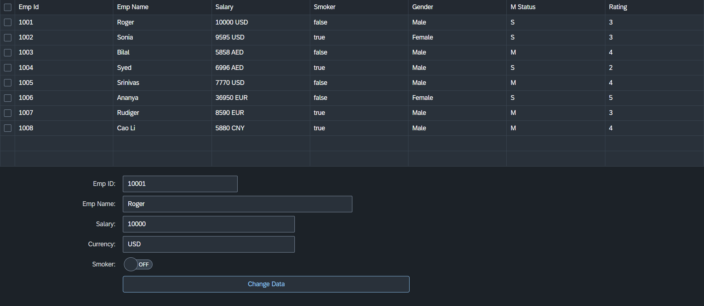
Hands – on: Aggregation Binding & Table
Now we will see how the Aggregation binding works with the help of the table control in SAP UI5.
Documentation of Table control:- https://sapui5.hana.ondemand.com/#/api/sap.ui.table.Table
Code Link:
Main.view.xml

Slide 44
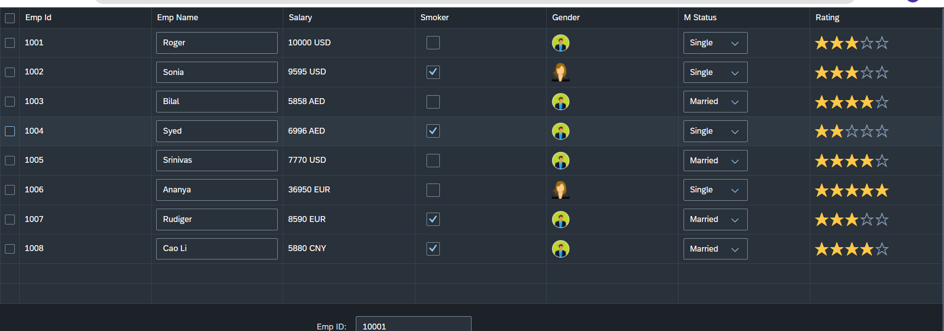
Hands – on: Table with Different Controls
Now we will add different type of controls to the UI table, like Input field, Image, Select, Rating Indicator, Check Box etc.
Code Links:-
MyXML.view.xml
sample.json

Slide 45
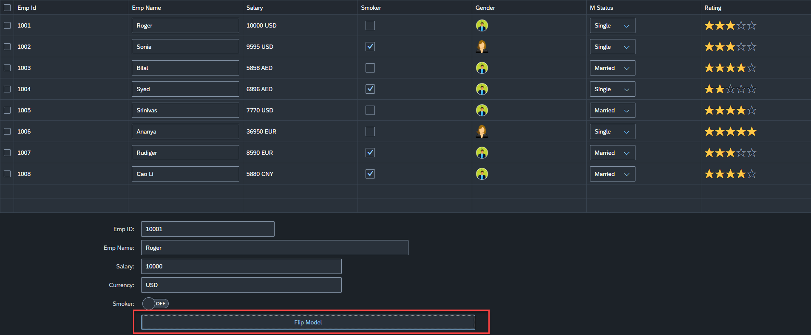
Hands – on: Flipping the default Model
Now we will change the default model in in the application on press of a button in the ui.
For this we will create a Flip button on the ui the default model bind to the application will be changed every time. (Flip Flop).
Along with that we will set the Visible number of rows in the Table to 5.
Code Links:-
Main.controller.js
MyXML.view.xml

Slide 46
Element Binding
To Understand the element binding first we have to understand about the what is element.
Element : Data related to the table inside the model memory is called as element ,
so, if we have 10 elements in the model we will get eventually 10 rows in table at runtime.
“empTab": {
"empId": 1,
"empName": "Roger",
"salary": 10000,
"smoker": false,
"currency": "INR",
"mStat": "S",
"rating": 2
}, ,
{
"empId": 2,
"empName": "Ananya",
"salary": 20000,
"smoker": true,
"currency": "INR",
"mStat": "S",
"rating": 4
}
Id | Name | Salary
1 | Roger | 10000
2 | Ananya | 20000
Element 0
Element 1

Slide 47
Element Binding continues..
Element binding is useful for containers and layouts containing other controls. All these child controls would be required to use properties of the same model object or model node, then element-binding is preferable.
An element to be bound to an object in the Model can be achieved by Element binding.
Use case:- On Select of a row in the table show the row data in a form.
The path of the element will always be the :
/entitysetname/index of the element
Table
Emp Id | Emp Name | Salary
{empId} | {empName} | {salary}
Element 0
/empTab/0
/empTab/1
/empTab/2
Element 1
Element 2
Simple Form
Field 0
/empId
All the content of Row 1 in the table is bind to all the fields in the form
Field 1
/empName
Field 2
/salary

Slide 48
Event Object Concept
Every UI5 event handler method will be entitled to receive an object free in the function, this object is know as event object.
This object is responsible to carry important information about the event.
For example : the rowSelectionChange event’s event object will let you know about the index of the row selected by the user.
Every Event object in SAPUI5 have exact 3 same function which are generic :
getSource() : will give the object of the source control from where event was originally generated. We can get object of the control, we can use it without giving an id.
getParameters() : every event carries a lot of the information about the user action e.g. row index of the selected row of the table. All this info come in form of parameters.
getParameter() : if we want to get single parameter value we can get it using this getParameter() function.
Note : best practice to use event object is put oEvent in the function’s parameter and using a hard debugger and then check the information got by the event object in browser’s console.

Slide 49
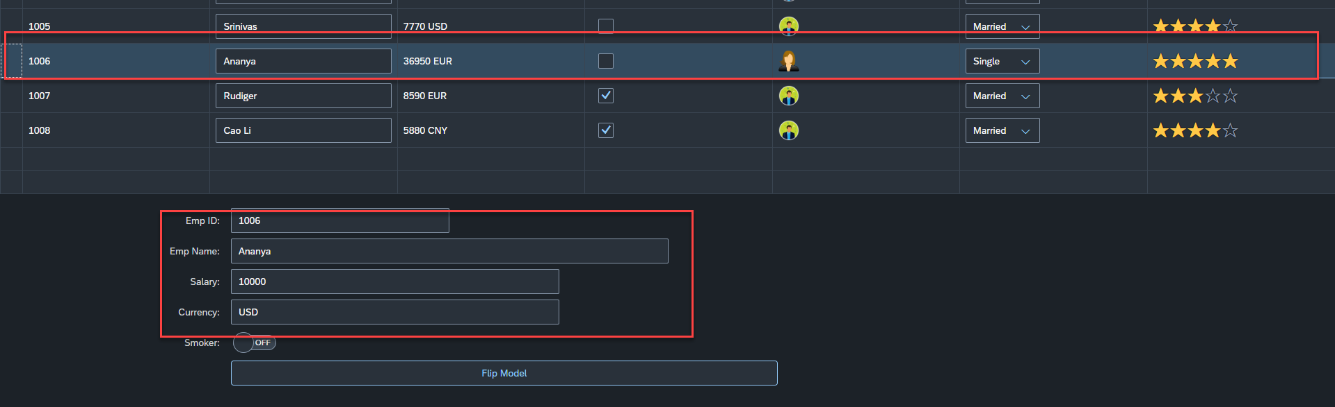
Hands – on: Element Binding
Make the table rows from multiselect to single select.
On select one row the data of that row have to shown in the SimpleForm by using the event object and element binding discussed in the previous slides.
Code Links:-
MyXML.view.xml
Main.controller.js

Slide 50

End of Day 5

Slide 51

Questions

Slide 52

Shekhar Vedi

Slide 53


We’re committed to empower you to be
Most Desirable Resource
through powerful training solutions.
We build the workforce of the future.
250+
Corporate Clients
30,000+
Learners Trained
25000+
Learners Placed
FREE WEBINARS
Sign up for free webinars with industry experts every fortnight!
Enroll Now!
Contact us today!
https://anubhavtrainings.com/

Slide 54




More from AnubhavTrainings.com

Slide 55
Title
Content

